Slide 1

Laravel
Engr.Rabbil Hasan

Slide 2
Why laravel ?
About 76% website / web application runs on PHP.
Laravel is the most powerful and popular framework of PHP.
Design pattern MVC
Website/web application/ Rest API
Backend everywhere
MySql, MS SQL, SQLITE .
Application security.
Session management .
Blade template engine
Organized application architecture.
No deploy difficulties , Can deploy everywhere.
Email, authentication, encryption, broadcasting,CSRF everything is here.

Slide 3
Previous Knowledge
Who has Basic of PHP MySQL
Who actually wants to learn
Designed for beginner to higher

Slide 4
Our Study Strategy
We should learn laravel as laravel
Laravel latest version 6x
First we learn all of features provided by laravel
Then we perform projects.
Deploy on real server

Slide 5


Projects
Portfolio Website
Shop Management

Slide 6
Terms & Conditions
I need 150+ or more videos to complete this series
Basic videos are free on YouTube
Rest of videos are paid
Short cut learner should avoid.
You should watch according to sequence.

Slide 7
Get Premium Videos
Website: Laravel.Rabbil.com
Helpline: Inside Description Below

Slide 8
Tools For Laravel
Composer
Xampp
Visual Studio Code

Slide 9
Create New Project And Run
composer create-project --prefer-dist laravel/laravel blog
Php artisan serve

Slide 10
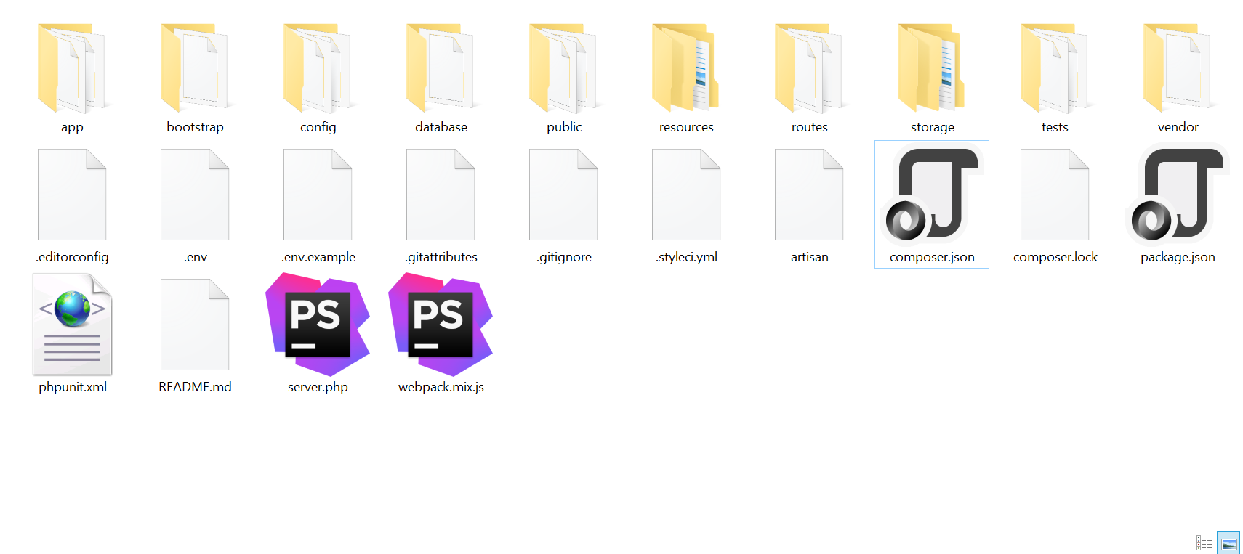
Project Structure

Slide 11
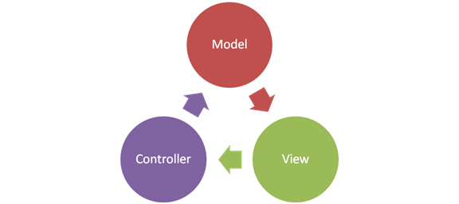
MVC – পদ্ধতি
Software Develop করার একটি উত্তম পদ্ধতি
Three Part Of Application
Data And Data Structure of Application
Logics of Application
Visible Part of Application
MVC: Software কে তিনভাগে ভাগ করে Develop করা, বা Source Code সাজানো
Model: Data Structure
View: The visible part of application
Controller : Logics of application

Slide 12

MVC
Data Insert
View
Controller
Model
Data Select
View
Controller
Model

Slide 13
Essential PHP Artisan command
Command | Action
Php artisan serve | To run laravel application
Php artisan make:Controller ControllerName | To make new controller
Php artisan make:Model ModelName | To make new model
php artisan make:Middleware MiddlewareName | To make middleware class
php artisan make:migration tablename | To make migration file
php artisan migrate | To run migration
php artisan cache:clear | Clear Application Cache
php artisan route:clear | Clear Route Cache
php artisan config:clear | Clear Config Cache
php artisan view:clear | Clear Compiled View Files

Slide 14
Laravel Basic Routing
Routing is a process to set url, that requested by browser
The route/web.php directory contains the definition of route files

Slide 15
Laravel Basic Routing With View
First Create View in resource folder with .blade.php extension
Then return this view file name in route call back function

Slide 16
Laravel Basic Routing With Controller
First Create Controller php artisan make:Controller ControllerName.
Then route with Controller name and method.

Slide 17
Laravel Basic Routing With Controller And View
Route
Controller
View

Slide 18
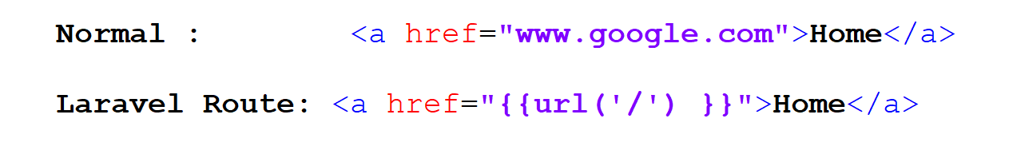
Routing With href link

Slide 19
Laravel Routing Parameter
Route
Controller

Slide 20
Laravel Routing Parameter
Route
Controller
View

Slide 21
Laravel Routing Group
Route::group( [ ] , callback);
Grouping multiple route we can provide common features to all
Using route group you can use common path prefix
Using route group you can use common middleware

Slide 22
Laravel Controller
Controller view কে রিটার্ন করে-
Controller থেকে View তে ডাটা Pass করানো যায়-
Controller এর মধ্যে Route parameter এর মাধ্যমে Data নেওয়া যায়-
Controller এর মধ্যে লজিক লেখা যায়-
Controller এর মধ্যে Model ব্যাবহার করে Database থেকে Select, Delete, Insert, Update করা যায়
Controller এর মধ্যে Middleware ব্যাবহার করা যায়-
Controller থেকে JSON Response দেওয়া যায় –
Controller এর মধ্যে JSON Request রিসিভ করা যায়-
এক কথায় Application এর প্রধান নিয়ন্ত্রন হয় Controller থেকে -

Slide 23
Laravel Controller Structure
Controller Create- php artisan make:Controller ControllerName
দাদা Base Controller
বাবা Controller
নাতি-পুতি/আপনি Those we create

Slide 24
Types of Laravel Controller
Custom Controller- যেটা আপনি নিজের মত করে করেছেন
Single Action Controller- যেটি একটি মাত্র কাজ করে
Resource Controller- যেটি সব ধরনের Http Request Handle করে CURD Operation করতে পারে।
Middleware Controller- যেটি Request এবং Response এর মধ্যে ব্যাবহার করা হয়

Slide 25
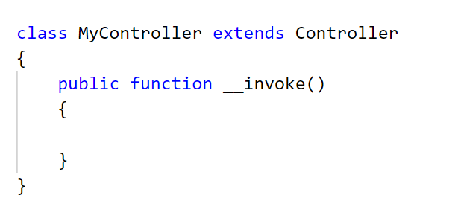
Single Action Controller
Single Action Controller- যেটি একটি মাত্র কাজ করে

Slide 26

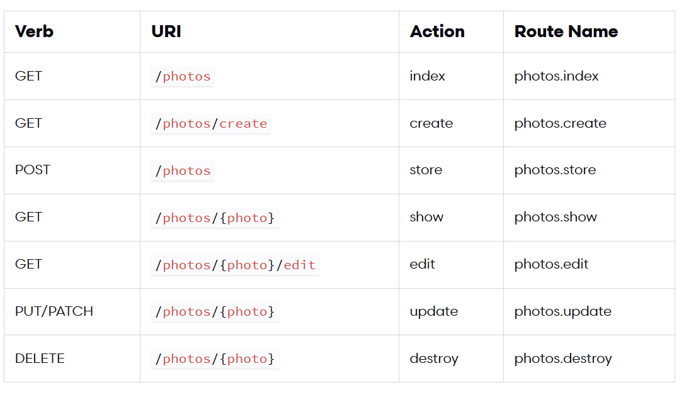
Resource Controller
Resource Controller- যেটি সব ধরনের Http Request Handle করে CURD Operation করতে পারে।
index()
create()
store(Request $request)
show($id)
edit($id)
update(Request $request, $id)
destroy($id)

Slide 27
Custom Controller
We experienced with
custom controller before

Slide 28
Laravel Views
Nothing but , html codes that create application interface.
Two types of views works with laravel.
.php extension view | .blade.php view
Normal php view | Laravel template engine
No special syntax | Special syntax
For all types of php application | Only for laravel
Conventional | Advance

Slide 29
Blade view
Template Inheritance
Components & Slots
Displaying Data
Blade & JavaScript Frameworks
Control Structures
Forms
Including Sub-Views
Service Injection
Extending Blade

Slide 30
Creating Simple Blade View
Blade View
Controller
Route

Slide 31
Pass & Display Data inside blade view
Blade statement is used to write php inside html view
{{…write php here….}}
{!! ….. Write php here….. !!}
{{…write php here….}} | {!! ….. Write php here….. !!}
Filter by htmlspecialchars function | Avoid Filter by htmlspecialchars function
prevent XSS (Cross site scripting ) attacks | No

Slide 32
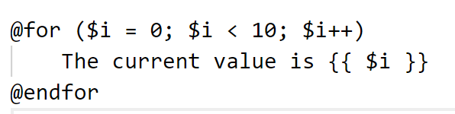
For Loop inside blade view

Slide 33
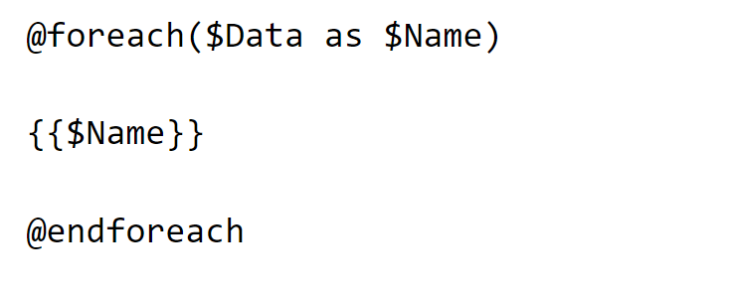
Foreach Loop inside blade view

Slide 34
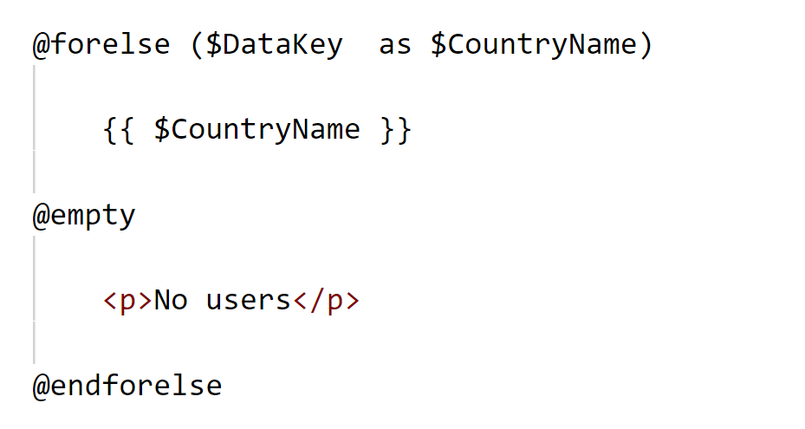
Forelse Loop inside blade view

Slide 35
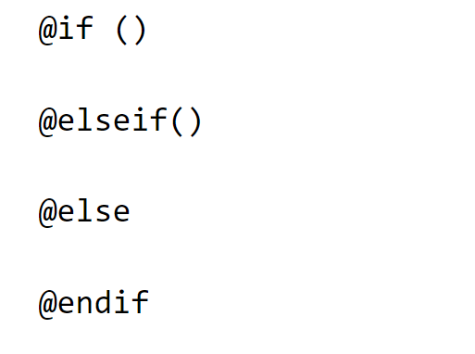
If else condition inside blade view

Slide 36
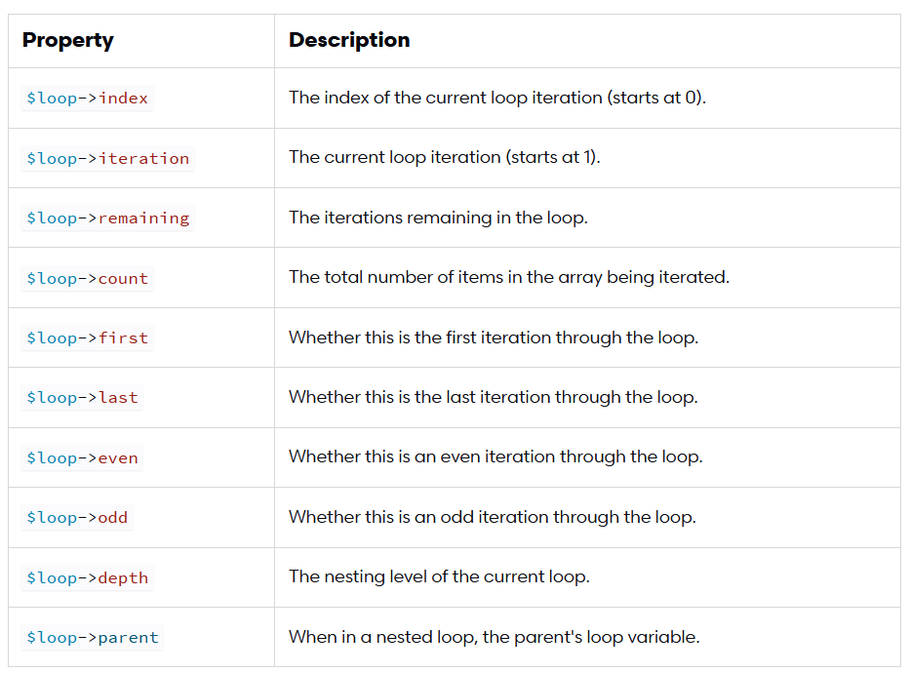
Loop special properties

Slide 37
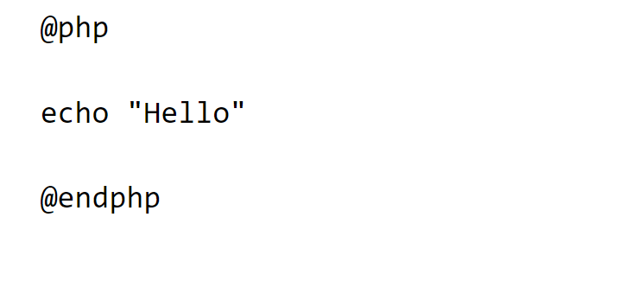
PHP Inside Blade View

Slide 38
Including SubView | Blade View
Simple Including Subview
Passing Data to Subview
Advance including

Slide 39
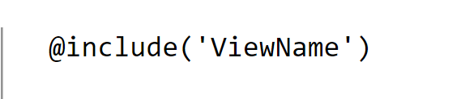
Including SubView | Simple

Slide 40
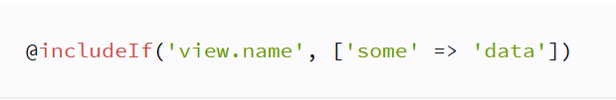



Including SubView | Advance

Slide 41
Blade Template Inheritance । Master Layout Concept
Master Layout
Contains Common Resource
Home Page
About page
Contact page
Product Page

Slide 42
Blade Template Inheritance । Master Layout Concept
@yield( )
@section( )
@extends()

Slide 43
Simple Static Website With Layout
Bootstrap
Home Page
About Page
Service Page
Portfolio

Slide 44
Laravel Migration
Laravel Migration allows you to create a table in your database.
You can modify the table by adding a new column or deleting an existing column.
Migration প্রস্তুতিঃ
Create a MySQL Database.
Connect with laravel.

Slide 45
Create New Migration
Php artisan make:migration MigrationFileName

Slide 46
Migration Structure
Up Method | Down Method
Works Only at Front Migration | Works Only For Migration Roll Back
Can Create Table, Column, Index etc… | Can Create Table, Column, Index etc…
Can Modify Table, Column, Index etc… | Can Modify Table, Column, Index etc…
Can Delete Table, Column, Index etc… | Can Delete Table, Column, Index etc…

Slide 47
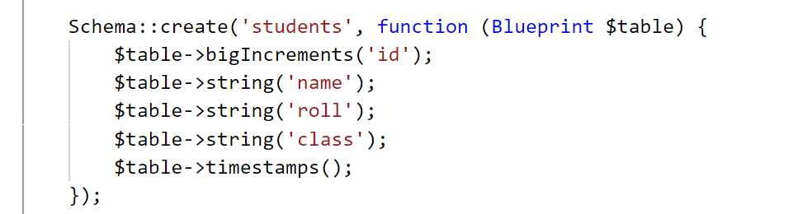
My First Migration

Slide 48
Migration Overview
Table Creation
Table Modification
Column Creation
Column Modification
Migration Roll Back
Roll Back With Down Method

Slide 49
Laravel Raw SQL Queries
BASIC CURD OPERATION

Slide 50
Laravel Query Builder
Retrieving Results
Aggregates
Selects
Raw Expressions
Joins
Unions
Inserts
Ordering, Grouping, Limit & Offset
Conditional Clauses
Inserts
Updates
Deletes

Slide 51
Eloquent ORM
MODEL=Eloquent ORM
Topics
Defining Models
Retrieving Models
Retrieving Single Models / Aggregates
Inserting & Updating Models
Deleting Models
Replicating Models
Controller
Model

Slide 52
Eloquent ORM
Creating New model
Set Model Properties

Slide 53
Eloquent ORM
মডেল ব্যাবহার ব্যাসিকঃ
Query Builder Use :
DB::table('students')….expression….
Model Use :
ModelClass:: ….expression….

Slide 54
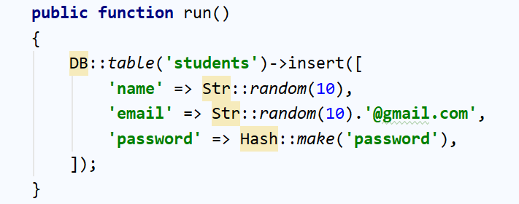
Database: Seeding
Seeding is a process to insert some dummy data in table
php artisan make:seeder UserSeeder
composer dump-autoload
php artisan db:seed --class=UserSeeder

